Slide 1
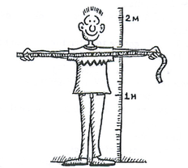
Measure your height and Arm span
Plot it on the scatter plot once you have the measurement
Notes:
Drawing a scatterplot as a class.
Draw up a set of axes on the whiteboard.
Show students how to plot the point on their using yourself as an Example (or Mr Morgan Height and arm span both 200cm)
When they measure their height and arm span they will then plot their data point on the scatterplot

Slide 2
24
7
30
Date
Scatterplots
EQ – how can we use scatterplots to analyse data?
Scatterplots compare how one variable is affected by another.
Trend line or line of best fit
The trend line can be used for making predictions and this is placed through the centre of the data.
Describing the relationship
Strength – Strong or Weak
Linear – Linear or Non Linear
Direction – Positive, Negative or No Relationship
5
Notes:
Draw the trend line on the scatterplot
Desribe the relationship of the graph.

Slide 3
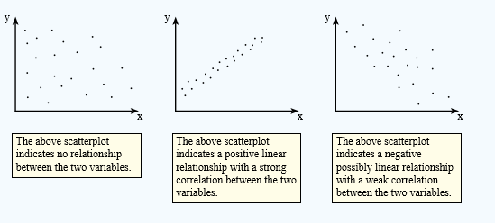

Slide 4
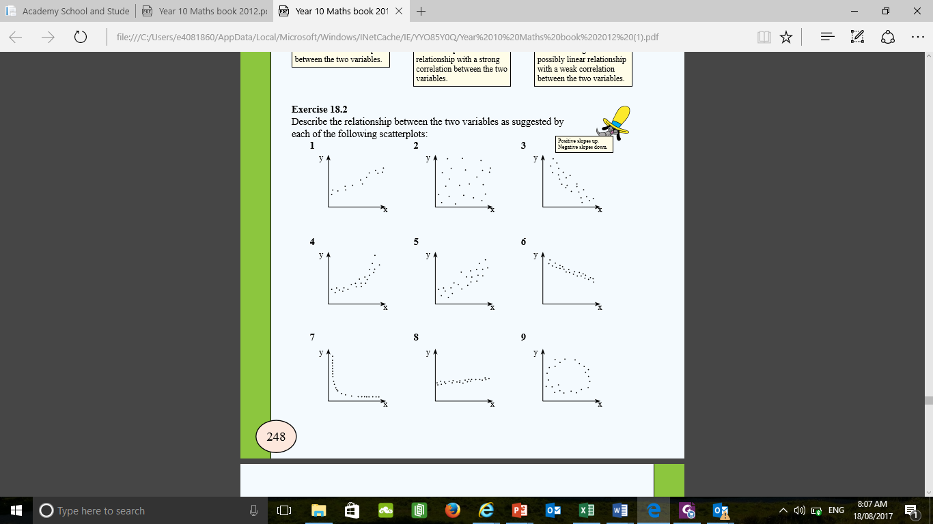
zsdxfcgvhbj

Slide 5
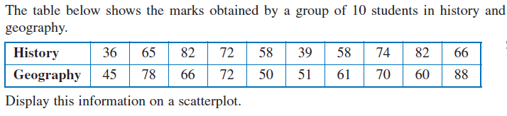
Geography
History
Notes:
Practice

